Slide 1
The Technology Value Stream
By Jason Palmeri

Slide 2
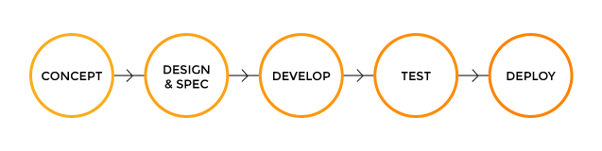
DevOps and The Technology Value Stream
DevOps combines development and operations to increase the efficiency, speed, and security of software development and delivery
DevOps’ Technology Value Stream is defined as the process required to convert a business hypothesis into a technology-enabled service or feature that delivers value to the customer
Because value is created only when our services are running in production, we must ensure that we are not only delivering fast flow, but that our deployments can also be performed without causing chaos

Slide 3
Lead Time
Part of the LEAN methodology
One of two commonly used ways to measure performance
The Lead Time clock starts when the request is made and ends when it is fulfilled

Slide 4
Processing Time
Also known as Touch Time or Task Time
The Process Time clock only starts when work begins on the customer request-specifically, it omits the time that the work is in queue, waiting to be processed

Slide 5
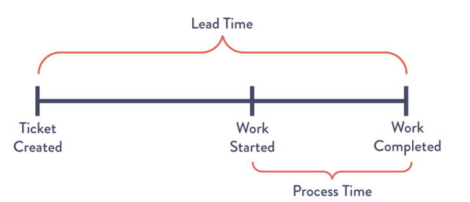
Lead Time vs. Processing Time
While they both provide a clock to show how long a request takes to process, the Lead Timer starts right away when a ticket is created, making it seem longer, while the Process Timer starts when we actually begin working on the request. Processing time omits the time that the work is in queue as shown in the figure.
The book writes about how “the proportion of process time to lead time serves as an important measure of efficiency. Achieving fast flow and short lead times almost always requires reducing the time our work is waiting in queues

Slide 6
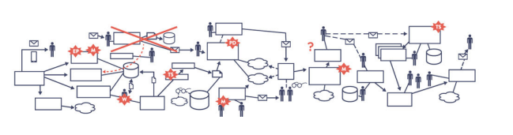
Common Scenario: Deployment Lead Timers Requiring Months
In large complex organizations working with “tightly coupled, monolithic systems” it is common for teams to find deployment lead times require months.
Long lead times can cause many issues such as merged code not working together as intended
With these issues it just adds more and more days/weeks to fix the issues

Slide 7
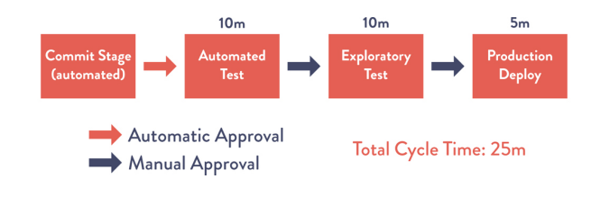
Ideal Scenario: Deployment Lead Times of Minutes
The DevOps Ideal is that developers receive fast, constant feedback on their work
This enables them to quickly and independently implement, integrate, and validate their code, allowing it to be deployed into the production environment
This can be achieved by continually checking small code changes using version control systems, and performing automated and exploratory testing against it.
This scenario is easily achieved when we work with modular, well encapsulated architecture.
With this scenario timers could be minutes and at the latest an hour

Slide 8
Citation
https://about.gitlab.com/topics/devops/
The Book

